Slide 1
FIFA World Cup 21th century
Japan & South Korea
Germany
South Africa
Brazil
Russia
Qatar
2002
2006
2010
2014
2018
2022
2002
2002
2005
2008
2011
2014
2017
2020
2022
Today
won by Brazil
2002 - 2002
won by Italy
2006 - 2006
won by Spain
2010 - 2010

Slide 2
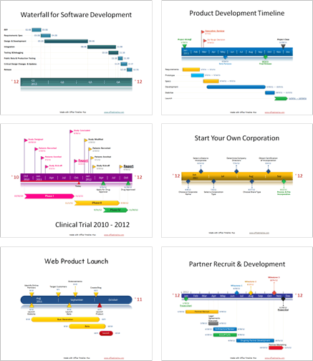
Award winning, free, timeline maker for Microsoft PowerPoint™
Simple, easy to use wizard.
Professional, quick results.
Built directly into PowerPoint!
What are professionals saying about Office Timeline Plus?
“
“I love this! I’ve been creating all these graphics manually for months and just wanted to smack myself upside the head when I saw this.”
“I can’t believe I’ve been using VISIO all these years! I've been missing out.”
“I like it because it's simple, intuitive and looks great! I used it with a client who likes the product and has changed how she represents her project schedules.”
Copyright © 2012, Office Timeline, LLC. All rights reserved.

Slide 3
Promotion Code: FPPT2012
GET 15% OFF!
Receive a 15% discount on your purchase of Office Timeline Plus edition when you use promotion code “FPPT2012”.
Learn More
www.fppt.com/officetimeline
Copyright © 2012, Office Timeline, LLC. All rights reserved.

